Slide 1

NEXT HIKES
IT SOLUTIONS
PROJECT – 1
On Data Acquisition Data Wrangling Using Pandas and NumPy
Presentation By
Jovita Tigga
Start Date : November 28, 2023
Submitted On : December 23, 2023

Slide 2
Table of Content
Problem Statement
Overview on Python Libraries.
Data acquisition
Data wrangling
Data Visualization

Slide 3
Problem Statement
Problem Statement
You are a junior data scientist assigned a new task to perform data wrangling on a set of datasets. The datasets have many ambiguities. You must identify those and apply different data-wrangling techniques to get a dataset for further usage.
Dataset
Download Dataset_1[dataset_1 - Google Sheets], Dataset_2[dataset_2.xlsx - Google Sheets], and Dataset_3 [dataset_3 - Google Sheets] and upload the datasets for your given analysis.

Slide 4
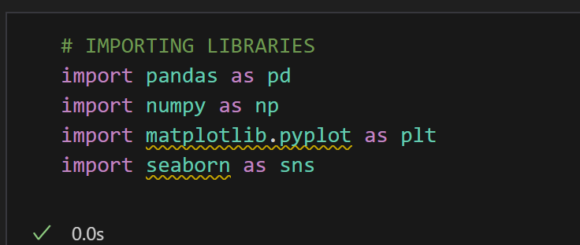
Overview on Python Libraries
Python is a versatile programming language with a vast collection of libraries that can be used to perform various tasks. The Python standard library consists of more than 200 core modules.
Many Popular libraries :
NumPy
Pandas
Scikit-learn
SciPy
Visualization libraries :
Matplotlib
Seaborn
All these libraries should be installed in the System

Slide 5
TASK 1 - Data Acquisition and Data Wrangling on dataset 1 and dataset 2 . [All methods to be applied for data wrangling concerning the listed above and combine data from dataset1 and dataset2, Work on central tendency. ].
OBJECTIVE
Acquiring data from Excel.
Reading Data; Data manipulation.
Merge datasets
Identify unique values
Drop unnecessary columns
Check the dimensions of the dataset
Check the datatype of the dataset
Check datatype summary
Treat missing values
Central tendency

Slide 6
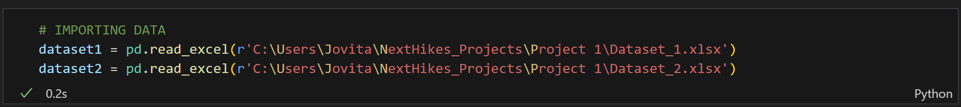
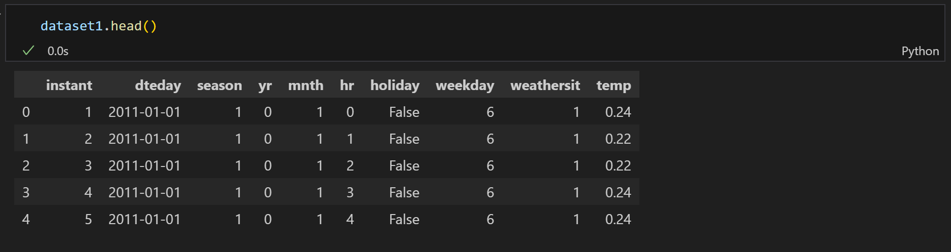
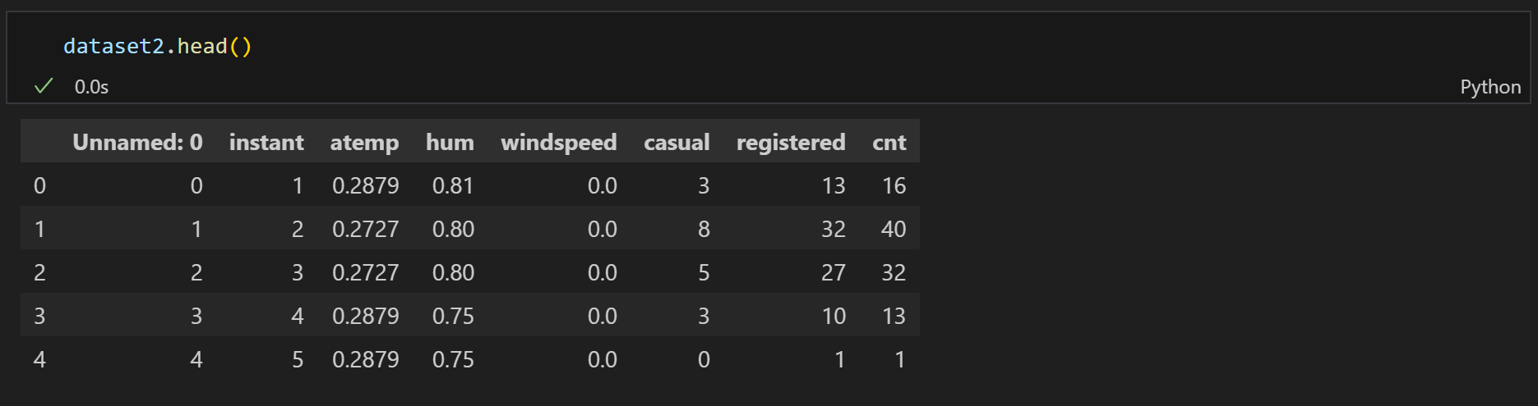
Imported Data from the given path.
The head () method returns a specified number of rows, string from the top.
The head () method returns the first 5 rows if a number is not specified.

Slide 7
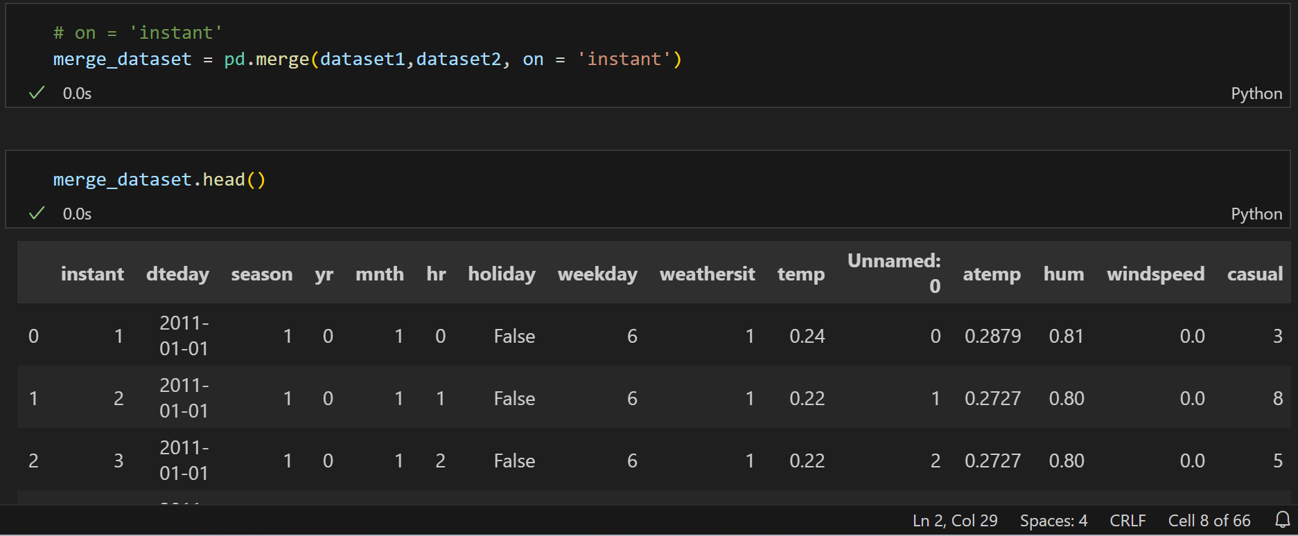
Merge datasets - Combing 2 datasets using a common column

Slide 8
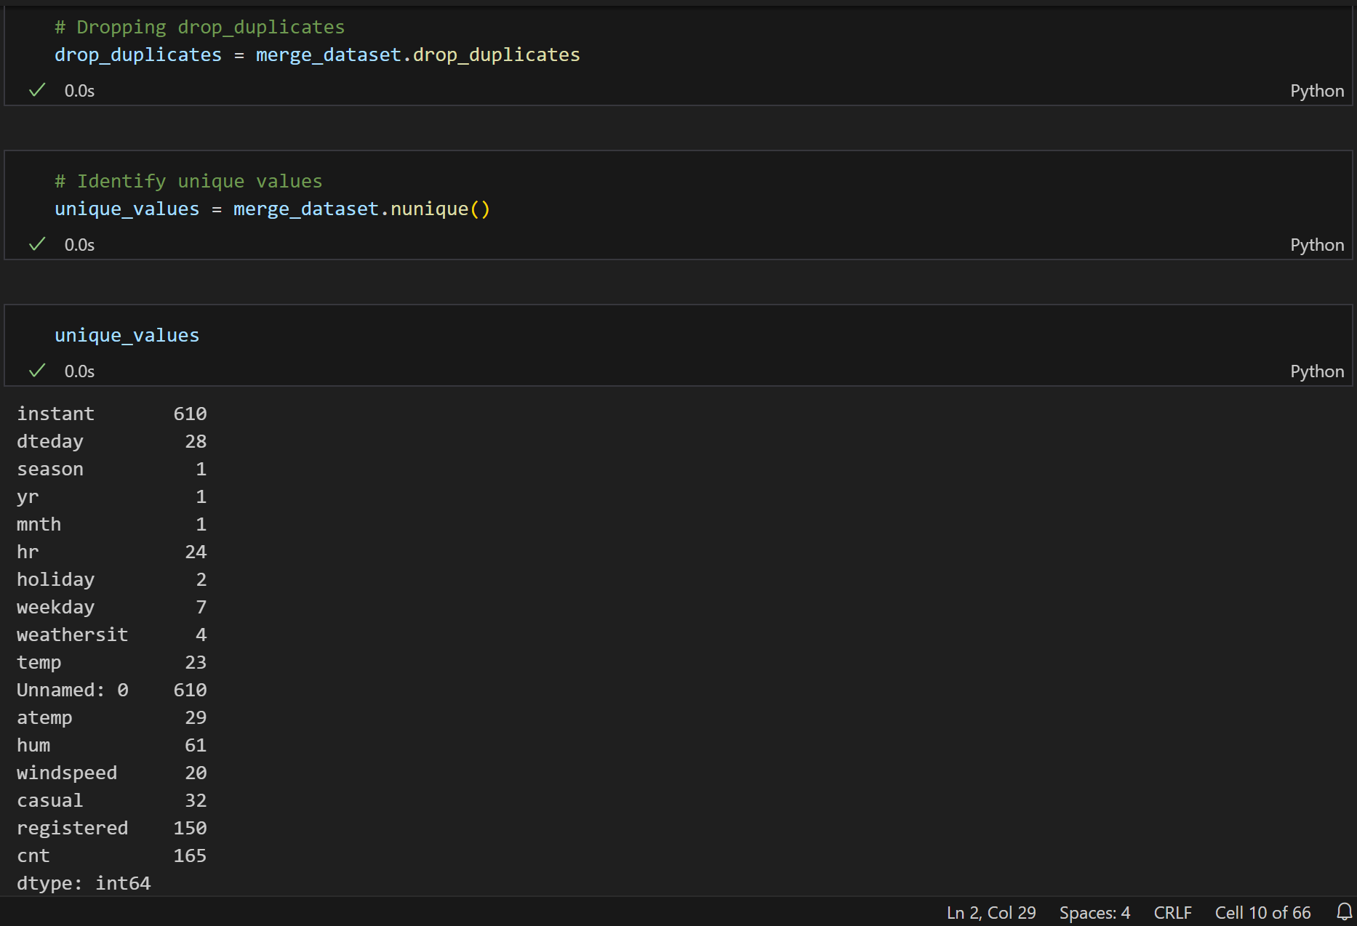
Dropped the Duplicates and Identified the unique values

Slide 9
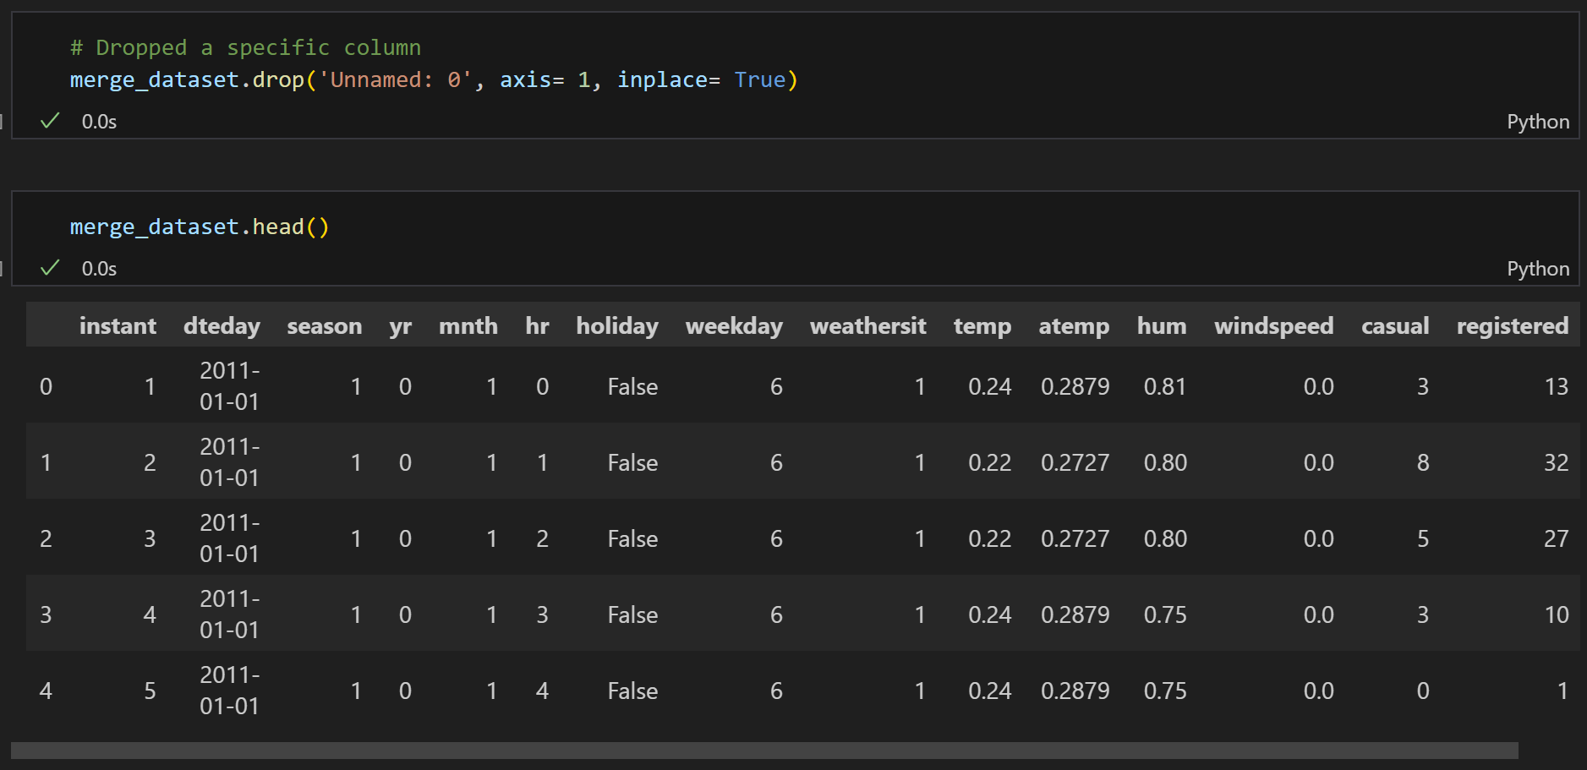
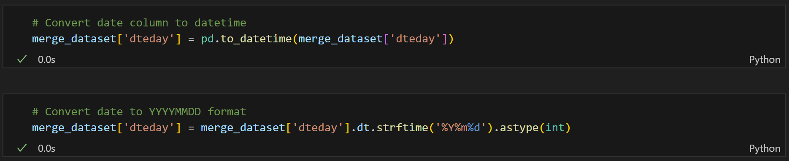
Dropped a specific column.
Converted the date column into Integer.

Slide 10
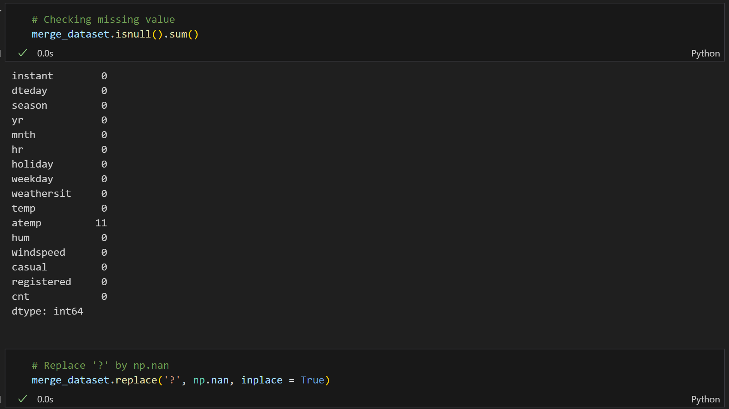
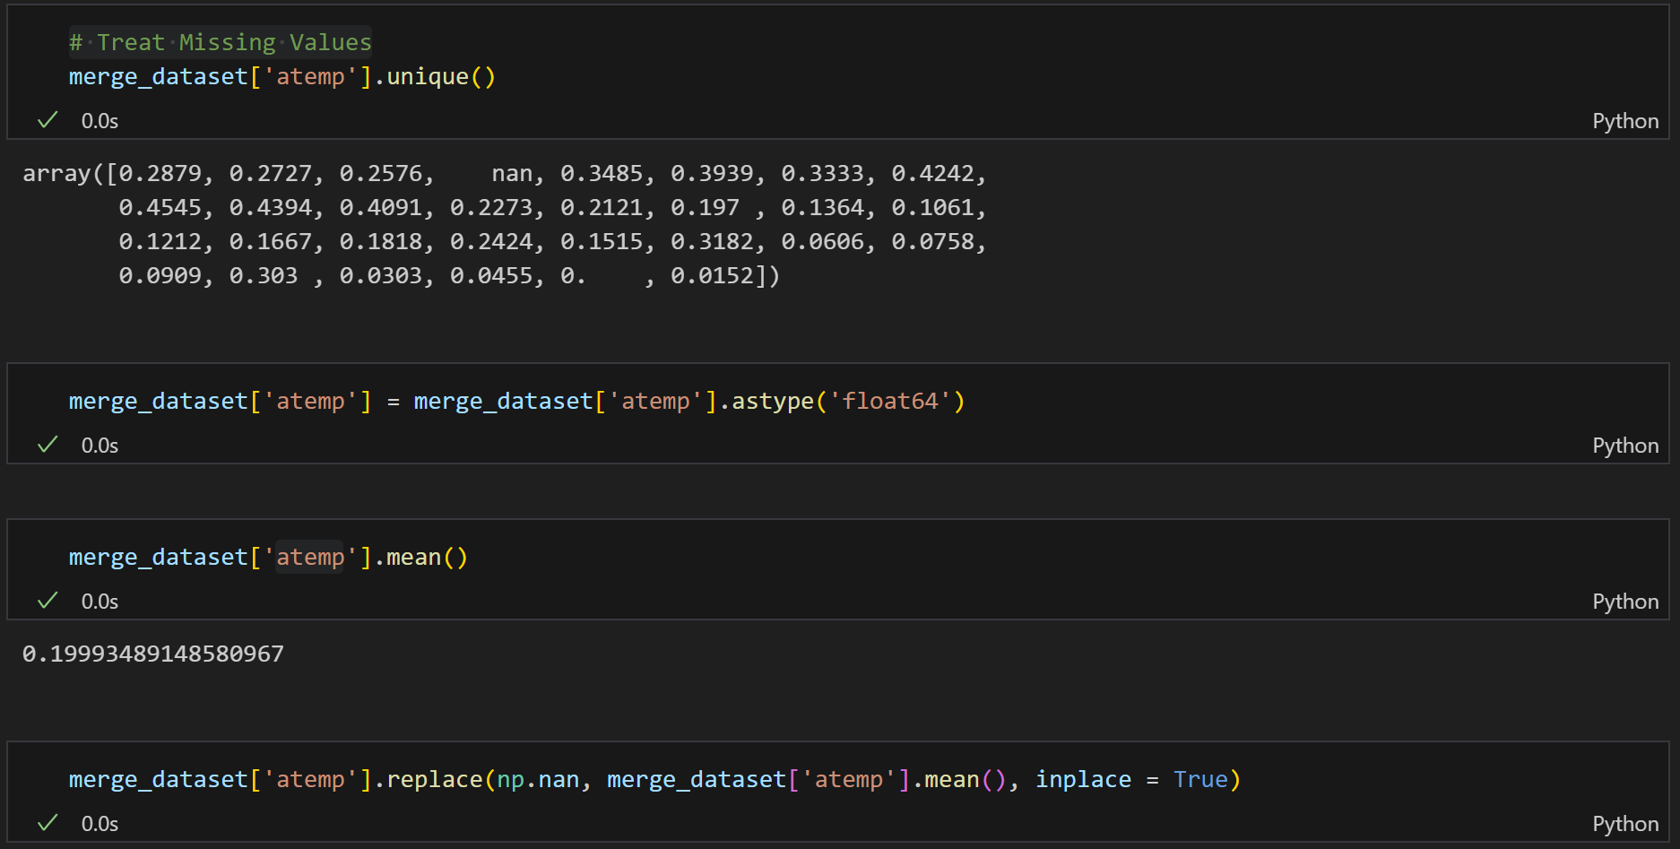
Identifying & Treating Missing Values

Slide 11
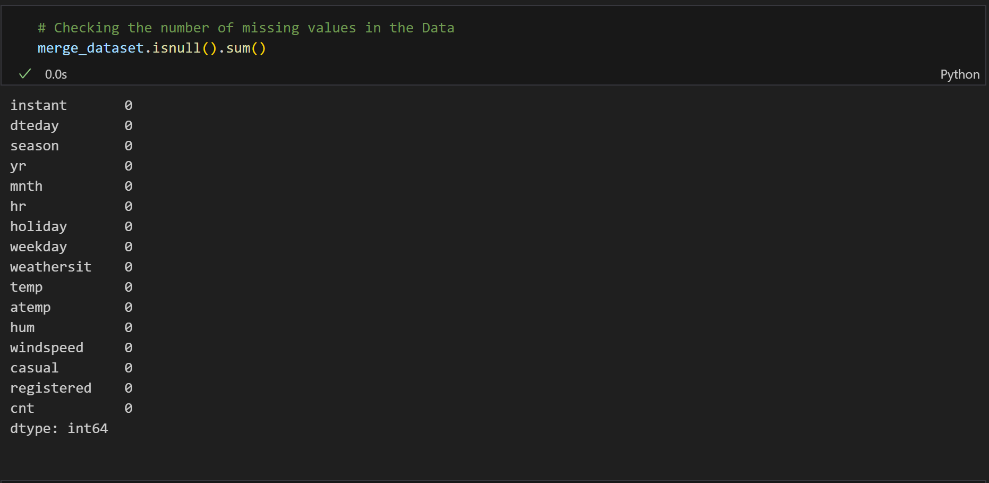
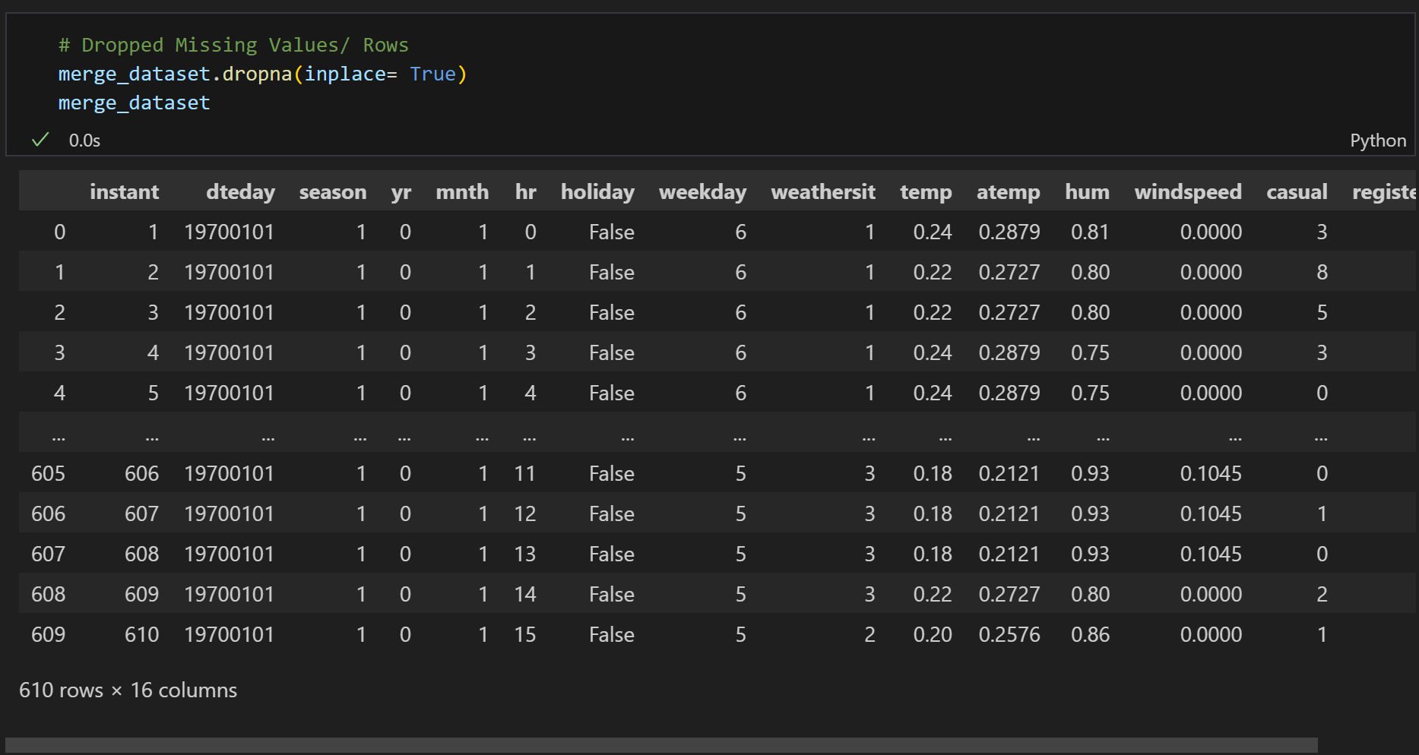
Checking missing values in the data after treating the same.

Slide 12
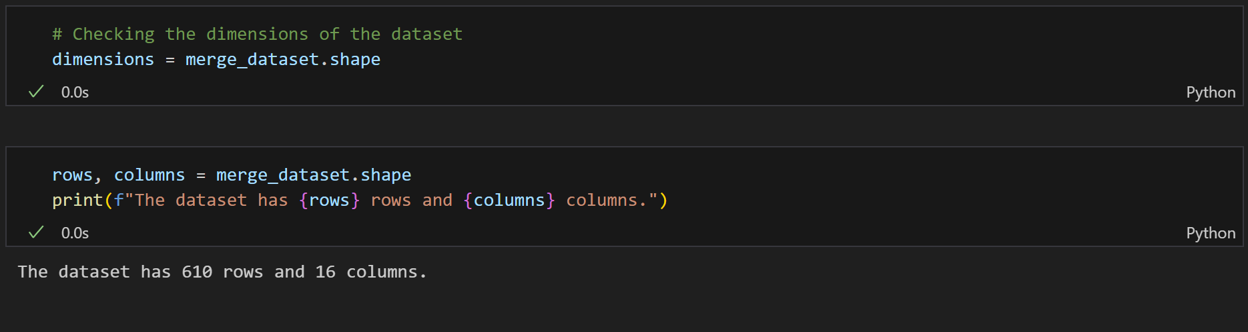
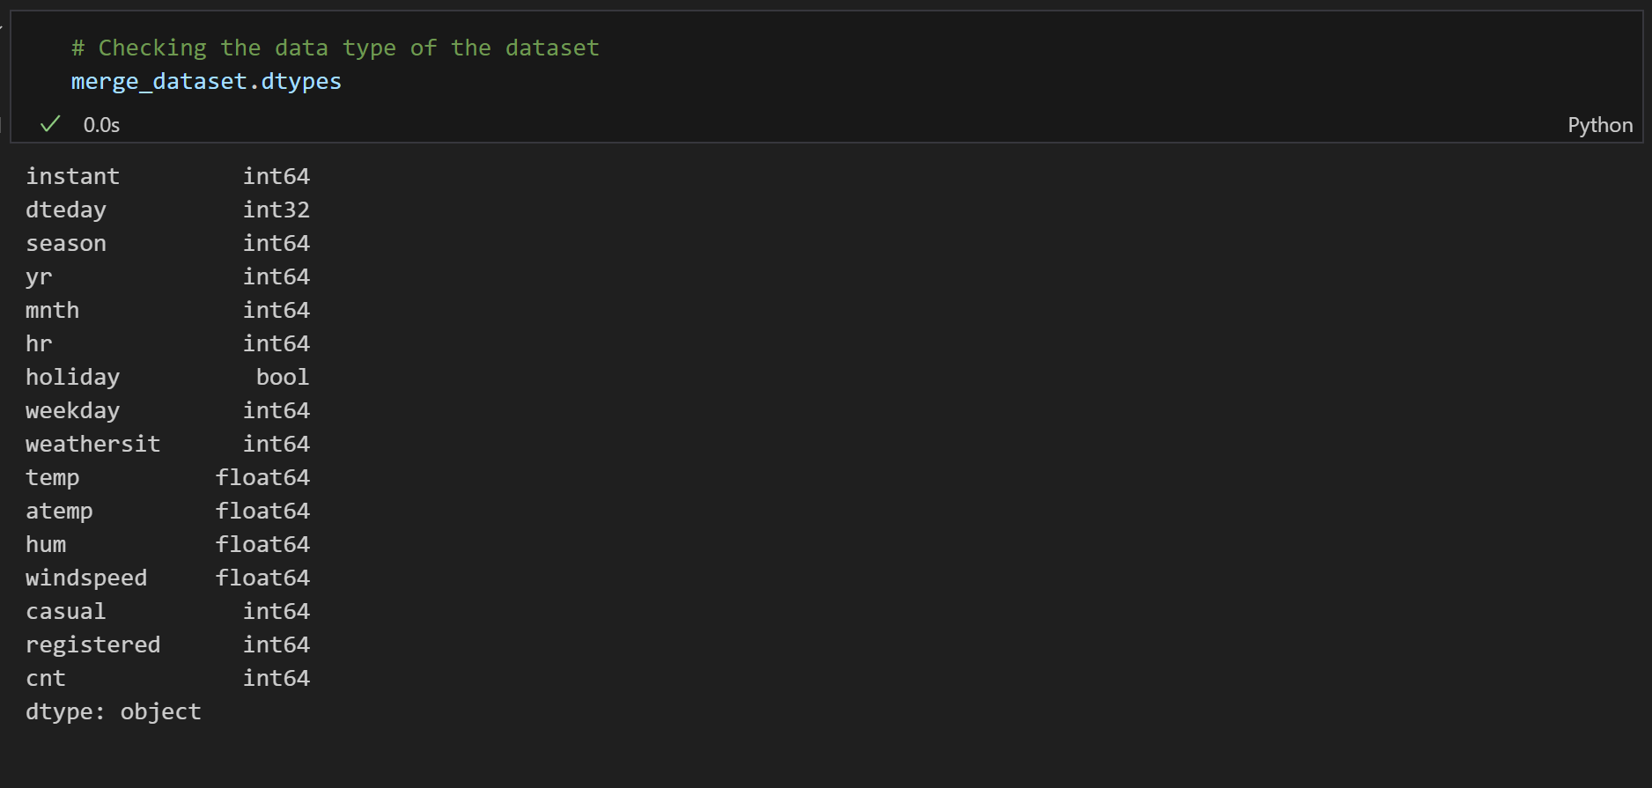
Checking the dimensions of the dataset.
Checking the datatype of the dataset.

Slide 13
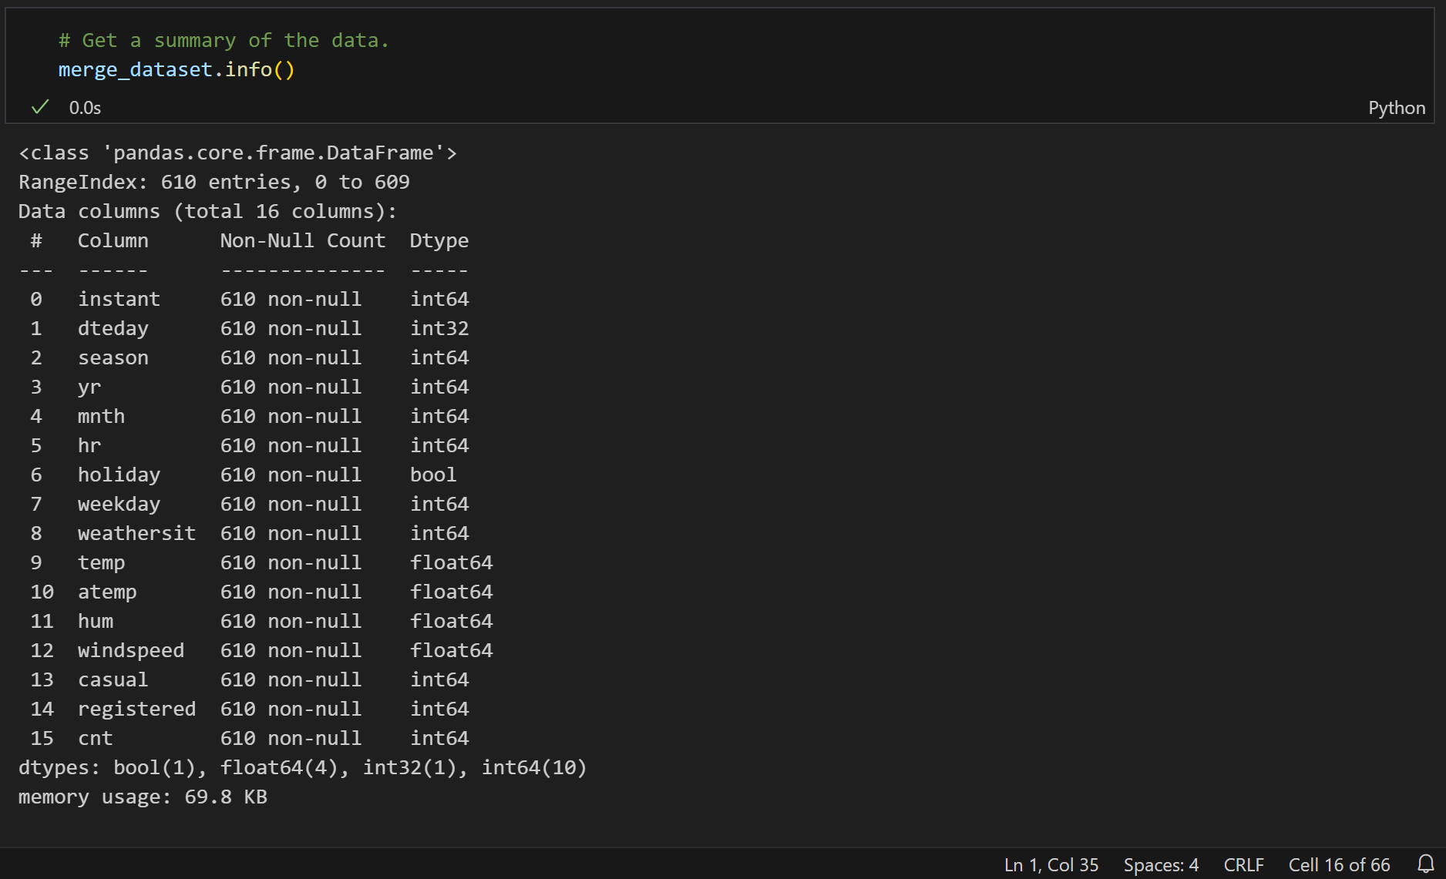
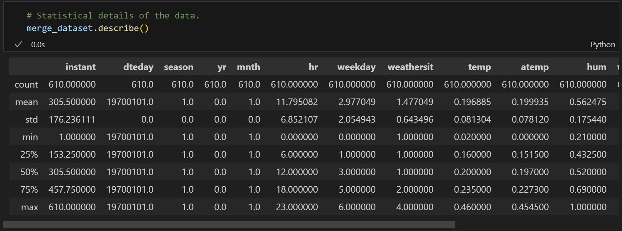
Summary of the data.
Statistical details of the data.

Slide 14
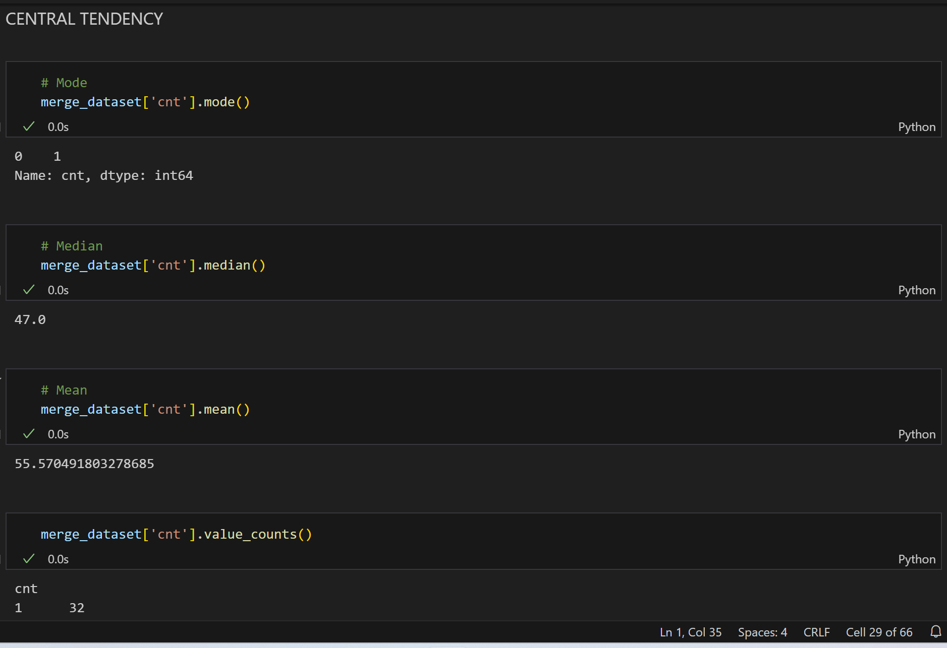
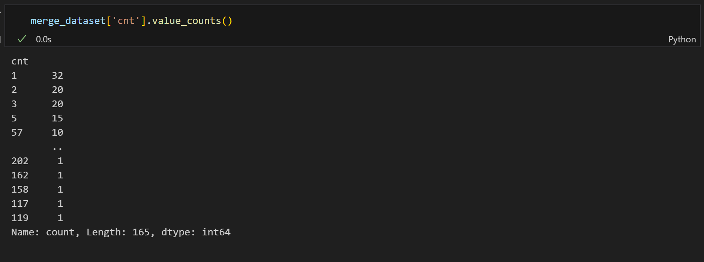
Central Tendency

Slide 15
Task 2: Data Acquisition and Wrangling on Dataset 3
OBJECTIVE
Concatenate Task 1 merged data with Dataset_3.
Work on missing values and outliers.
Skewness and correlation of the data.

Slide 16
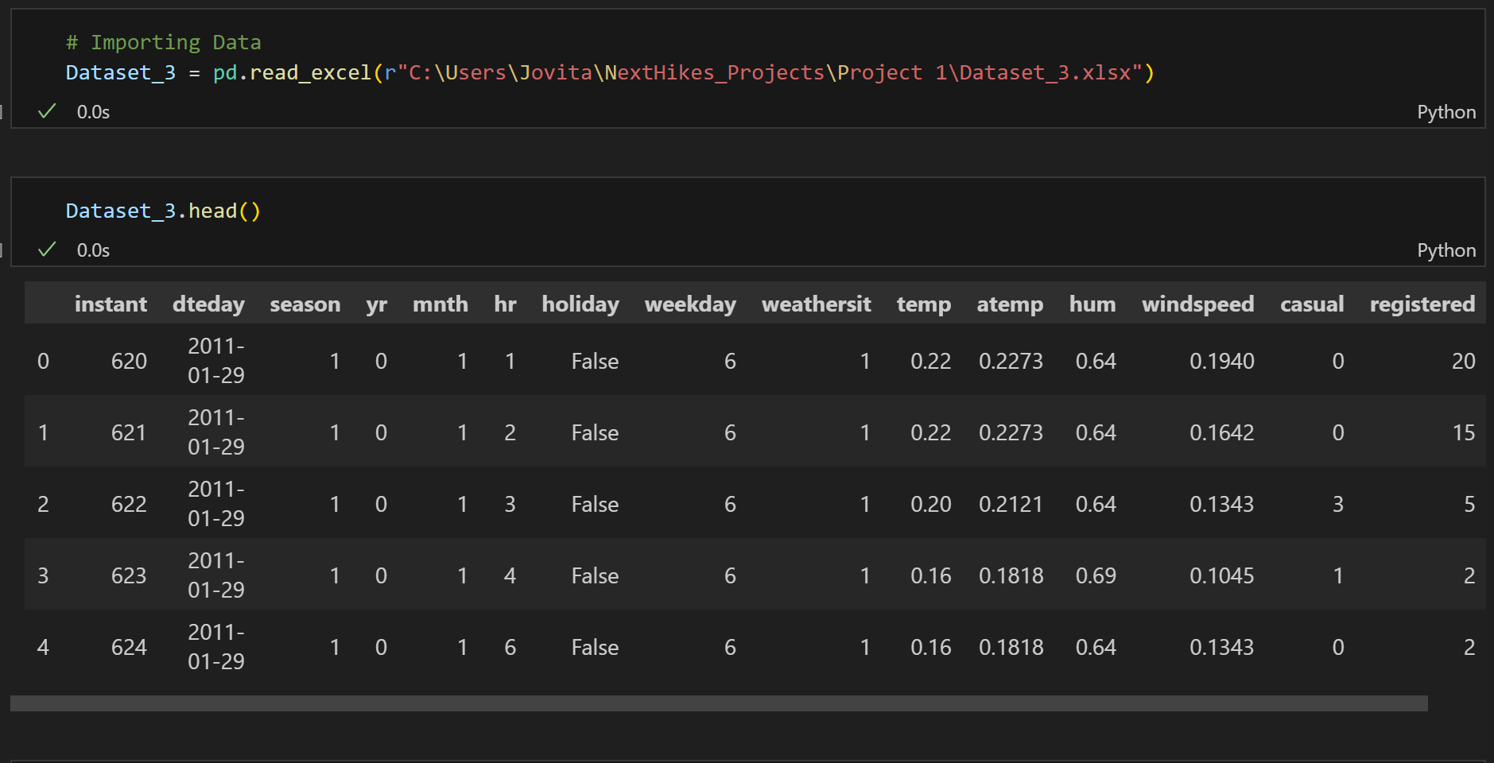
Imported Data from the given path.

Slide 17
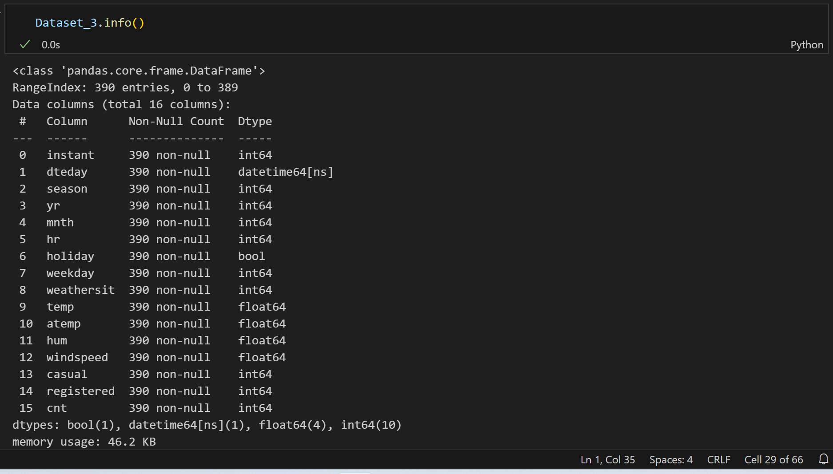
Summary of the data.

Slide 18
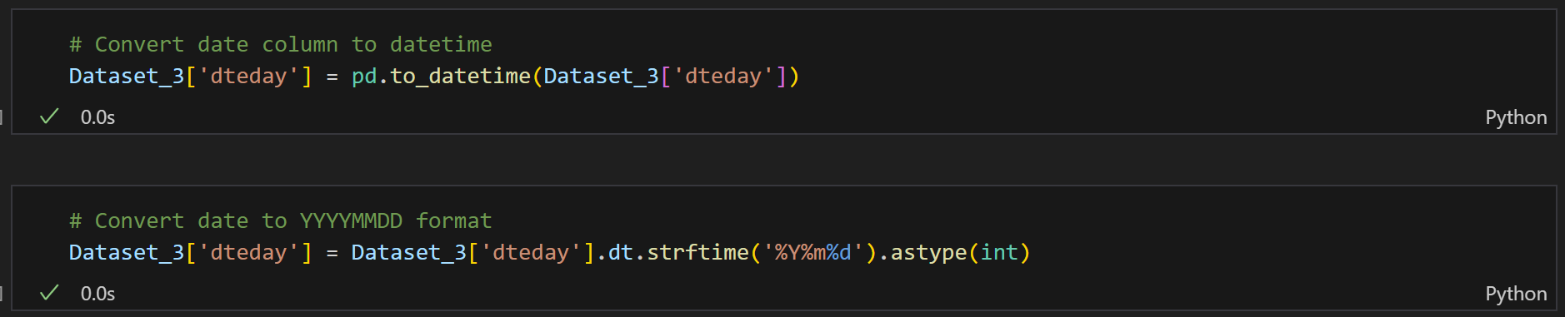
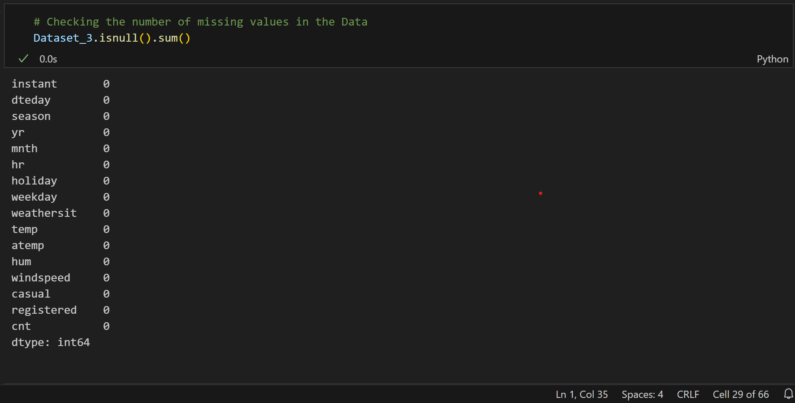
Converted the date column into Integer.
Checked missing value.

Slide 19
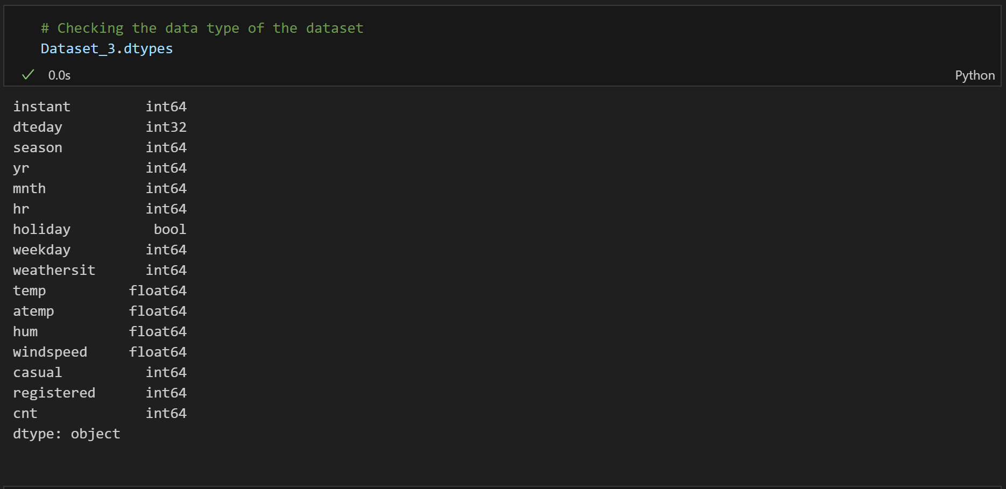
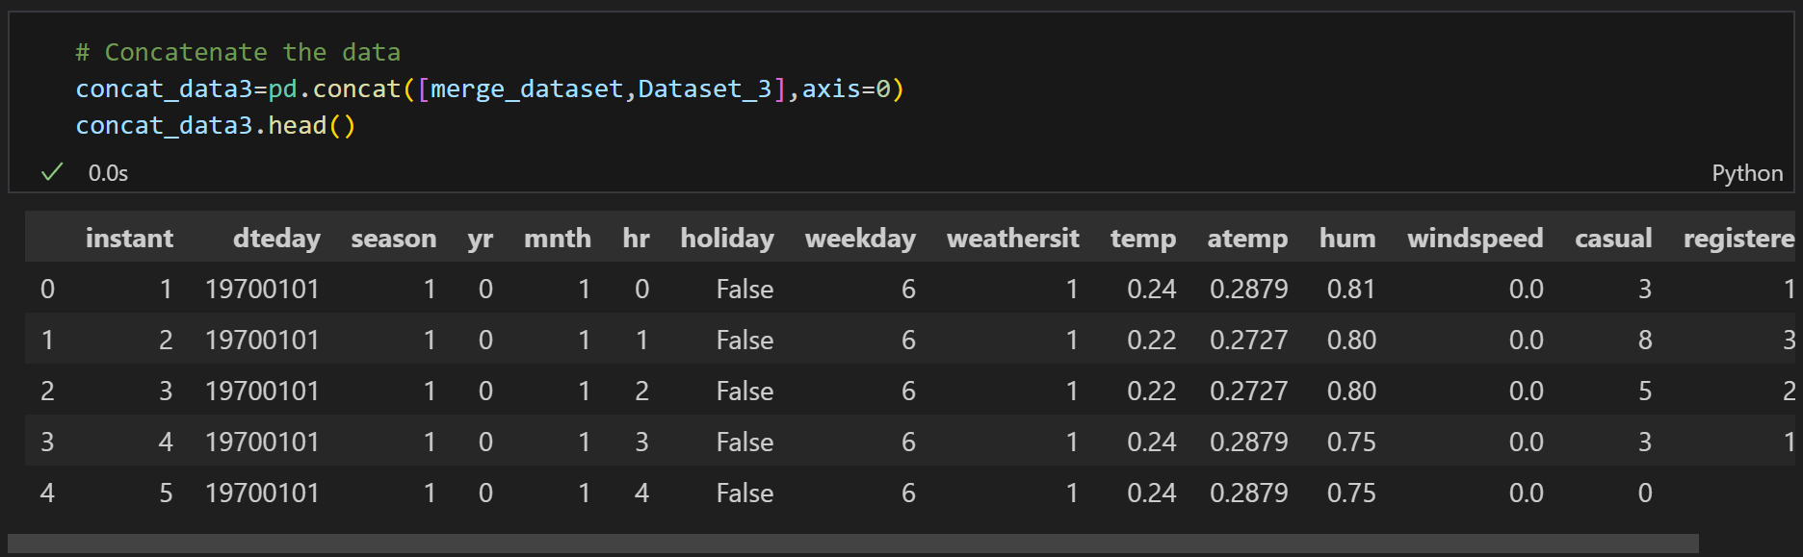
Checking the datatype of the dataset.
Concatenate the data.

Slide 20
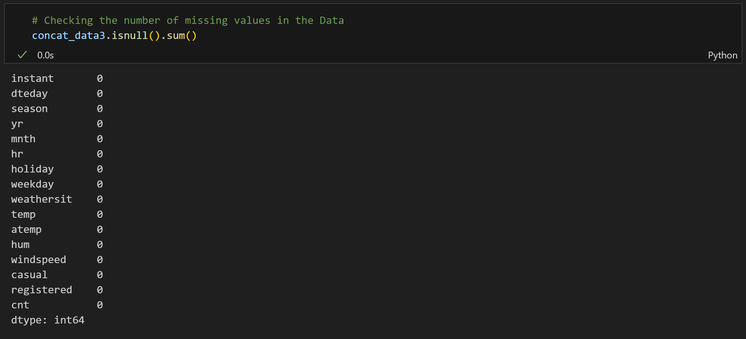
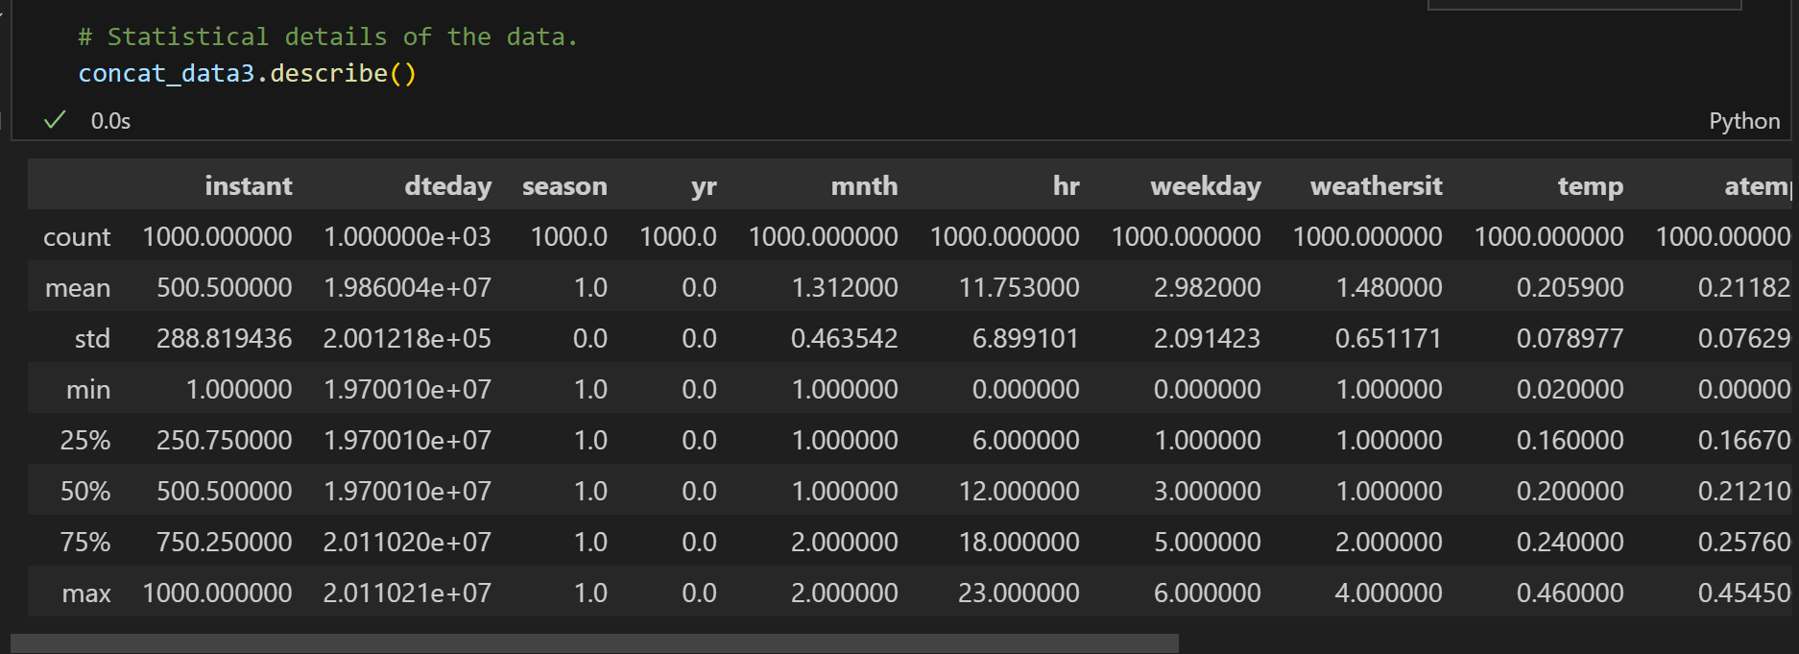
Identifying the missing value .
Statistical details of the data.

Slide 21
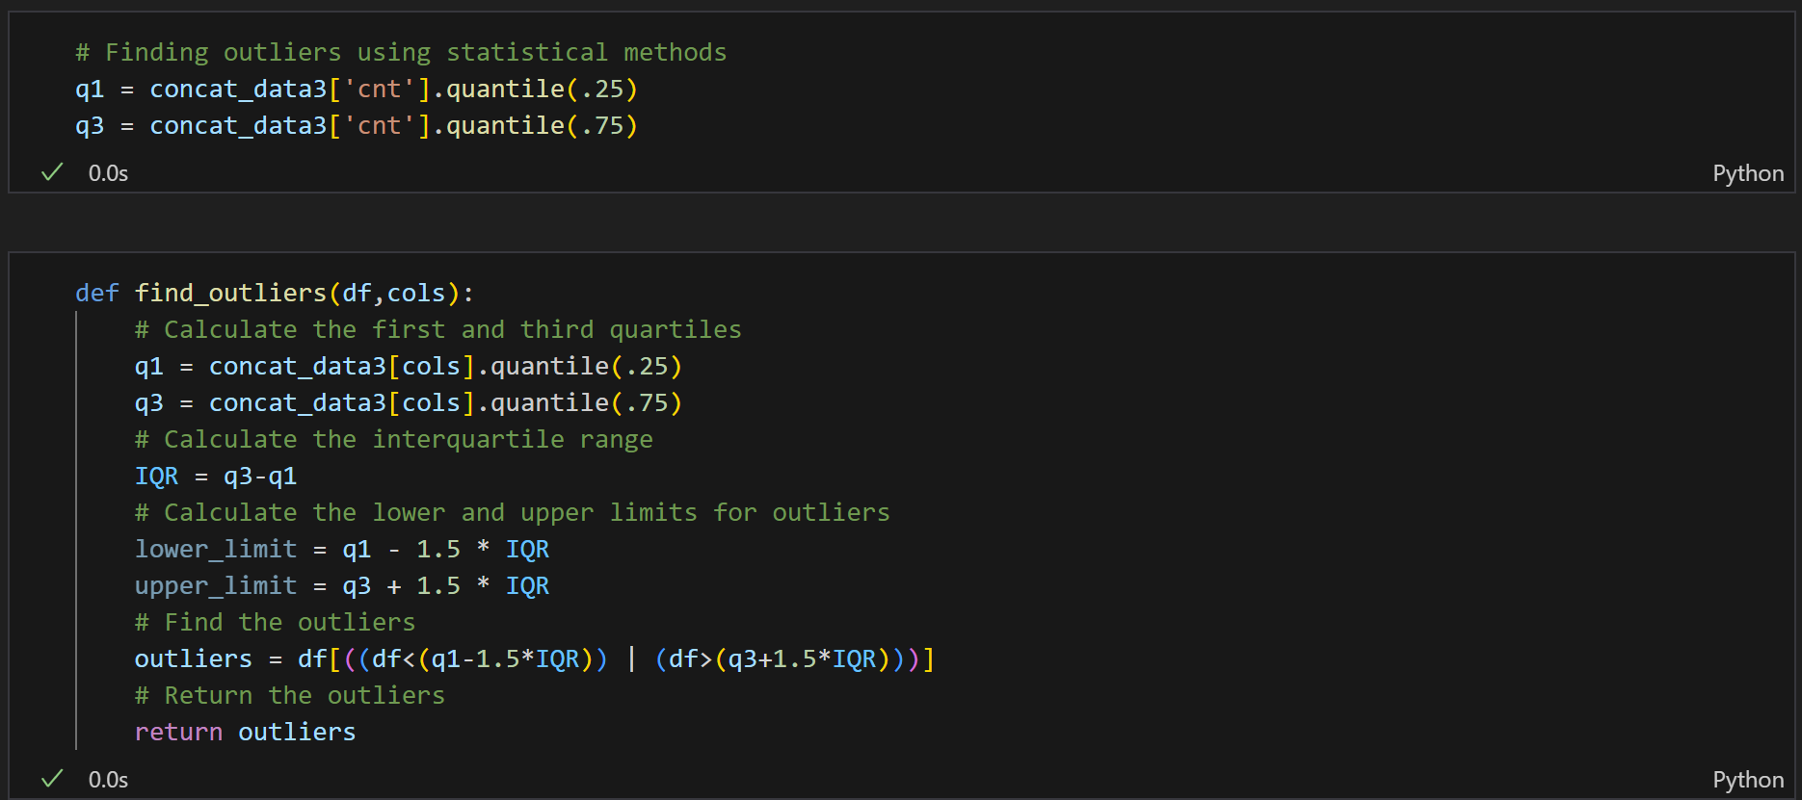
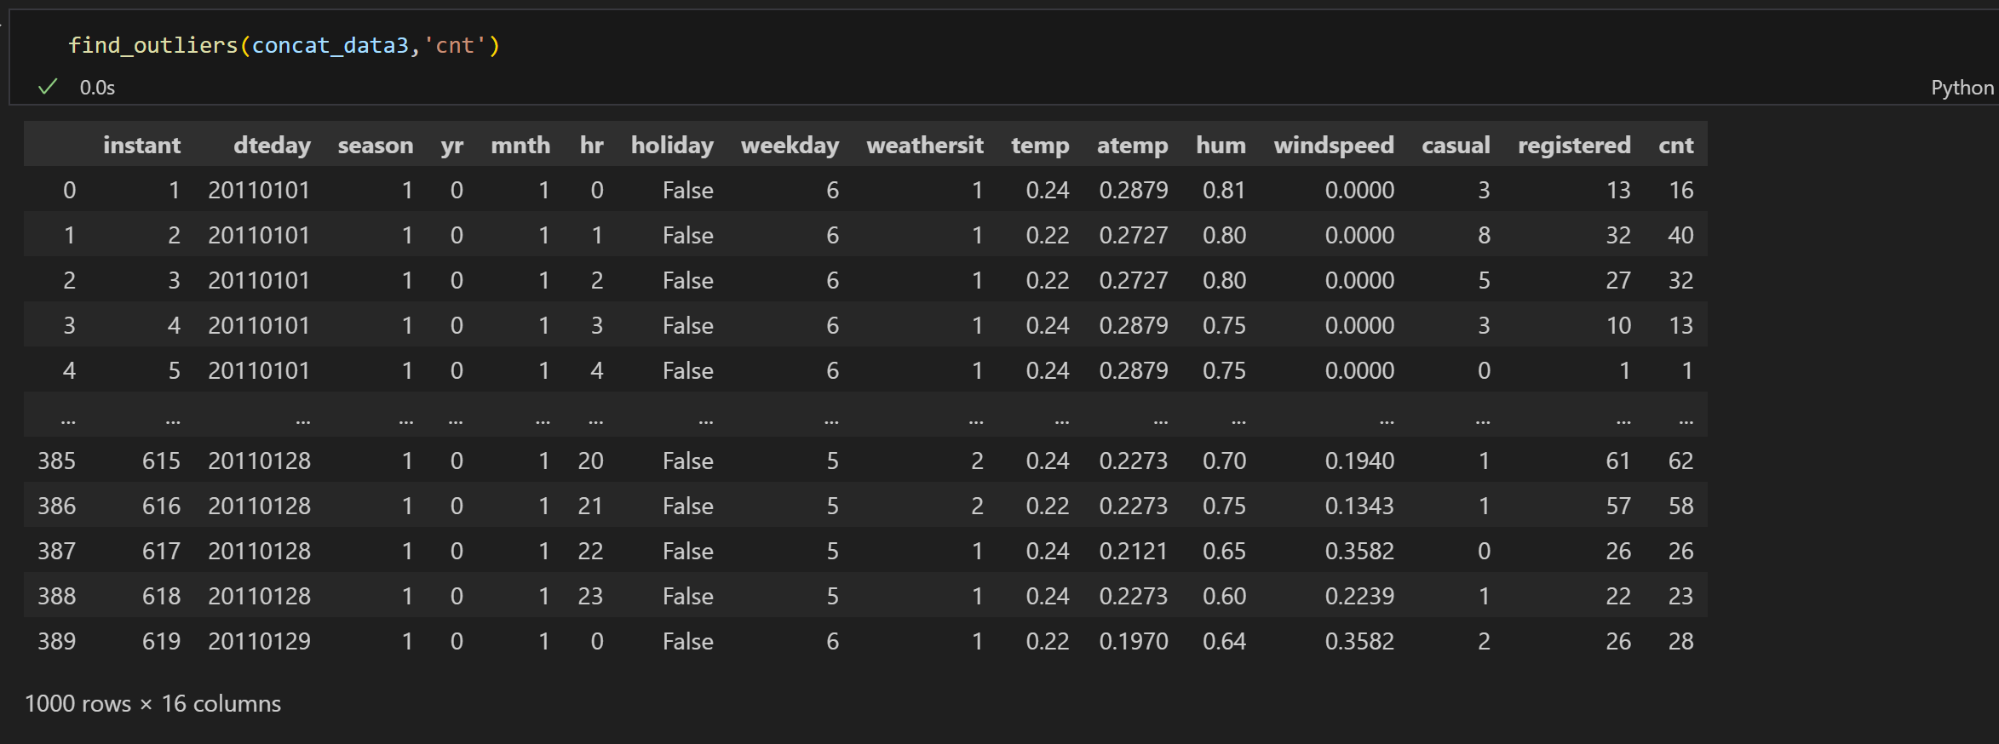
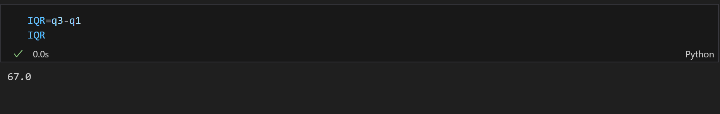
Finding outliers using statistical method - Interquartile range method

Slide 22
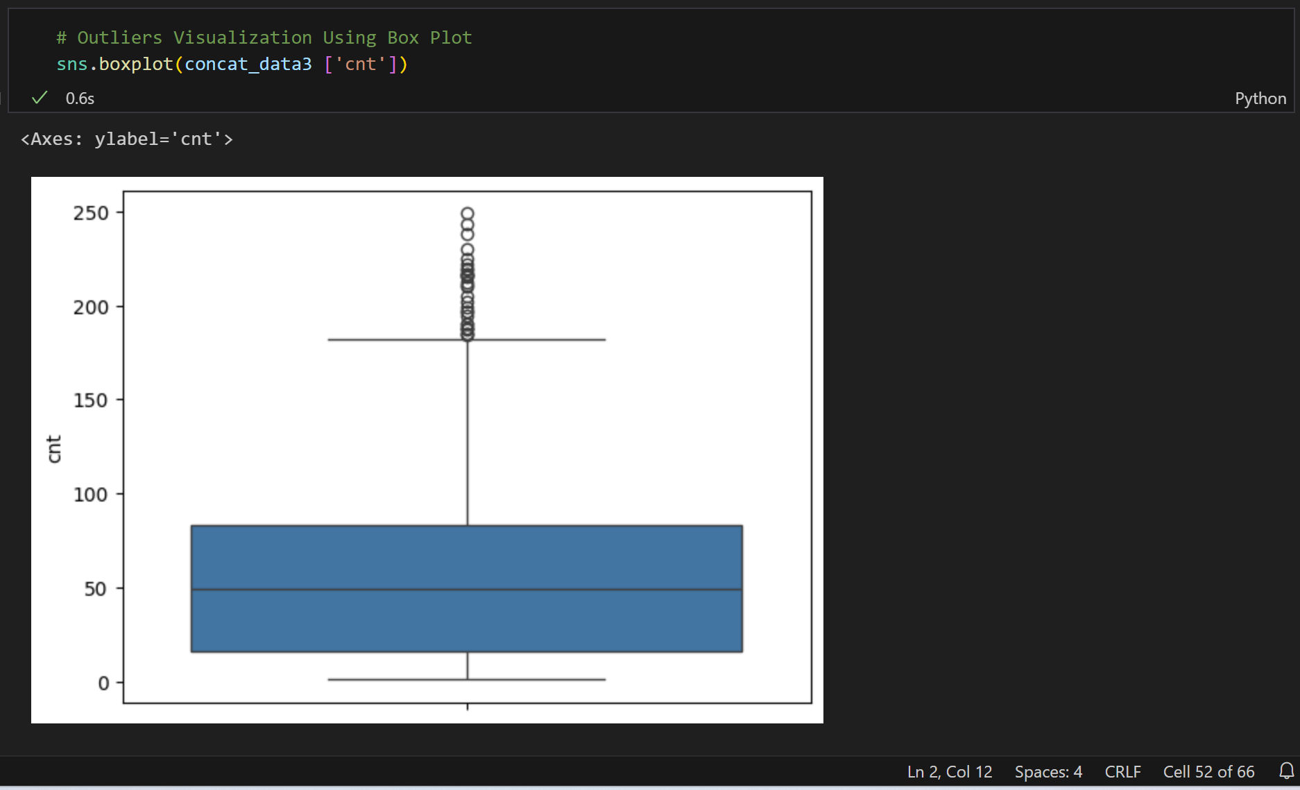
Outliers Visualization Using Box Plot

Slide 23
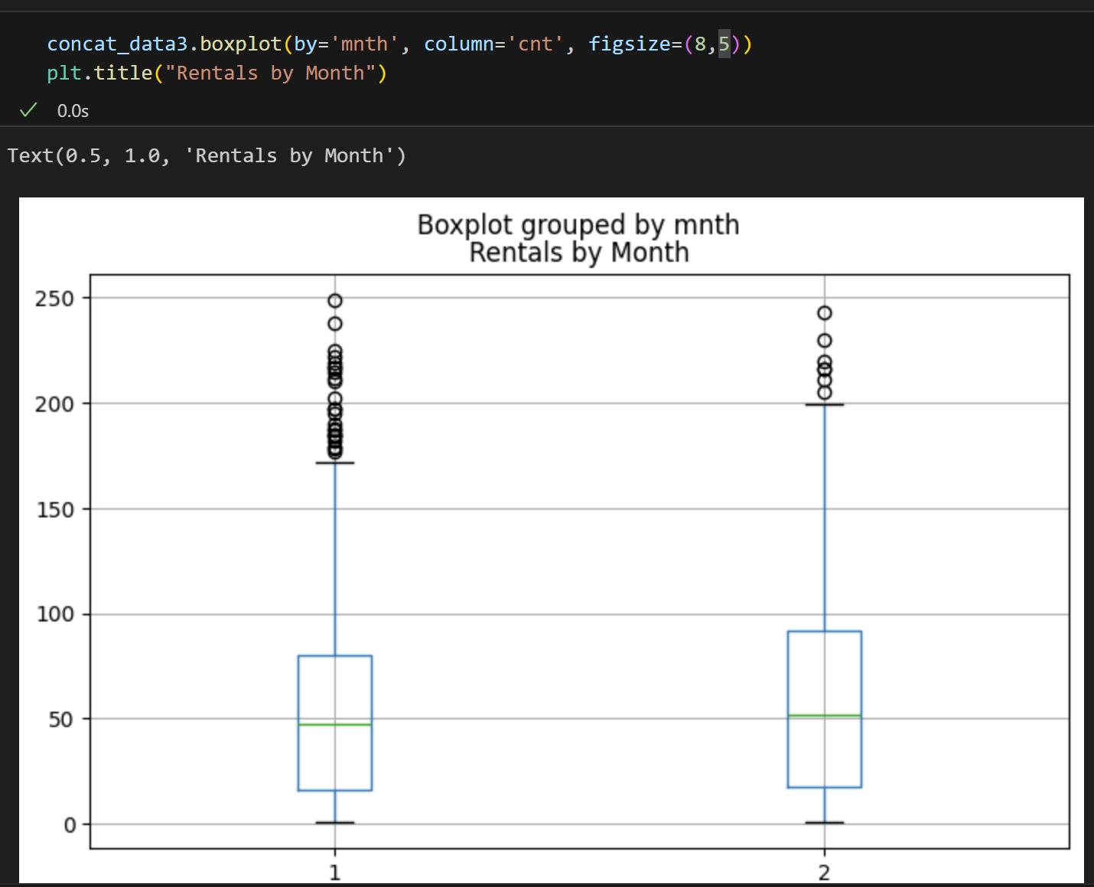
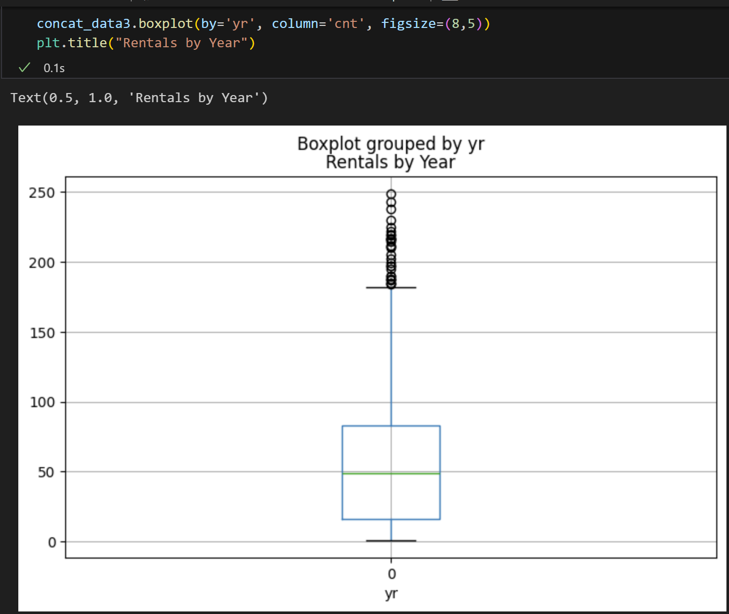
Outliers
Rentals by Month
Rentals by Year

Slide 24
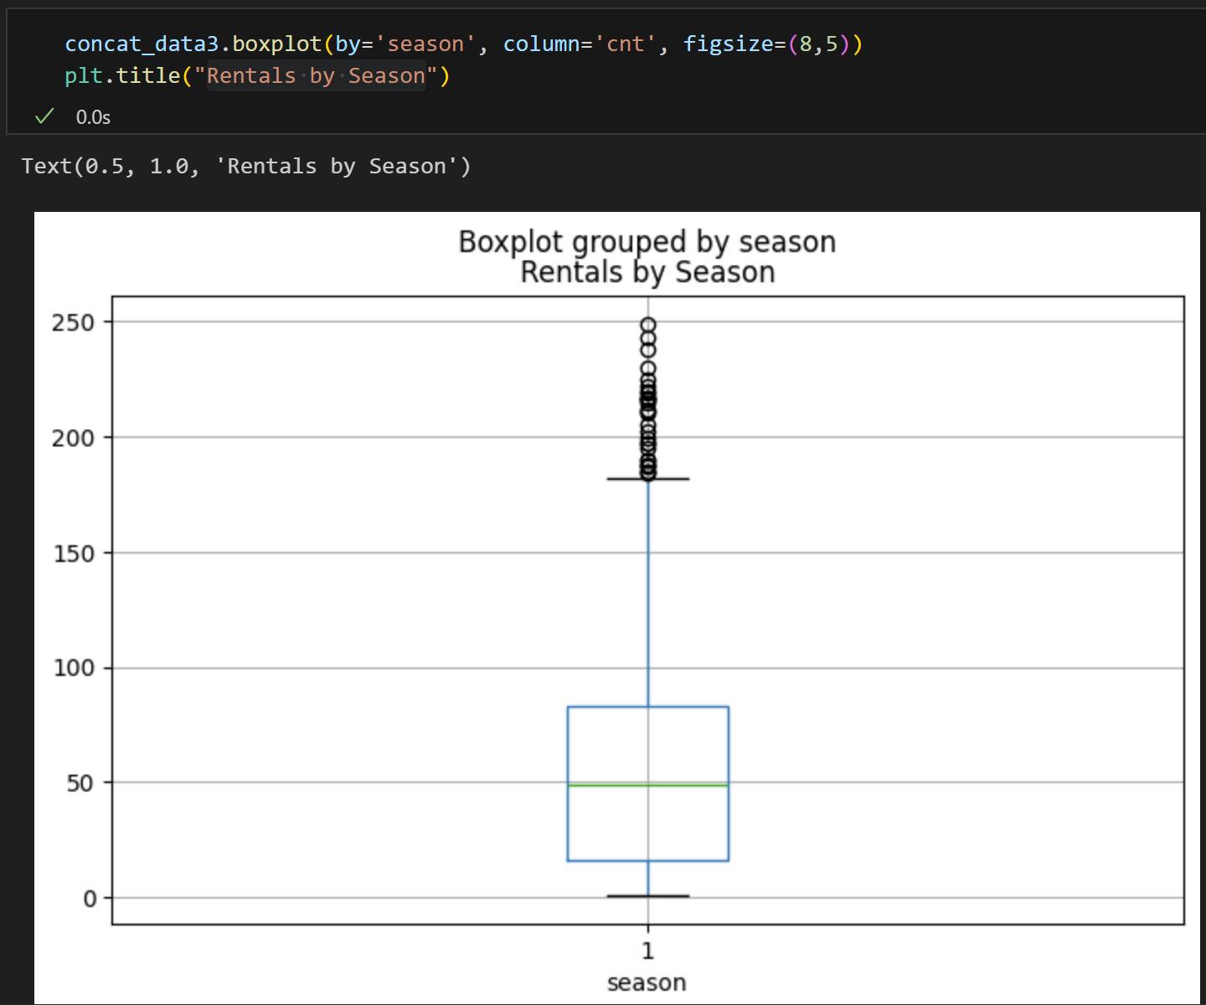
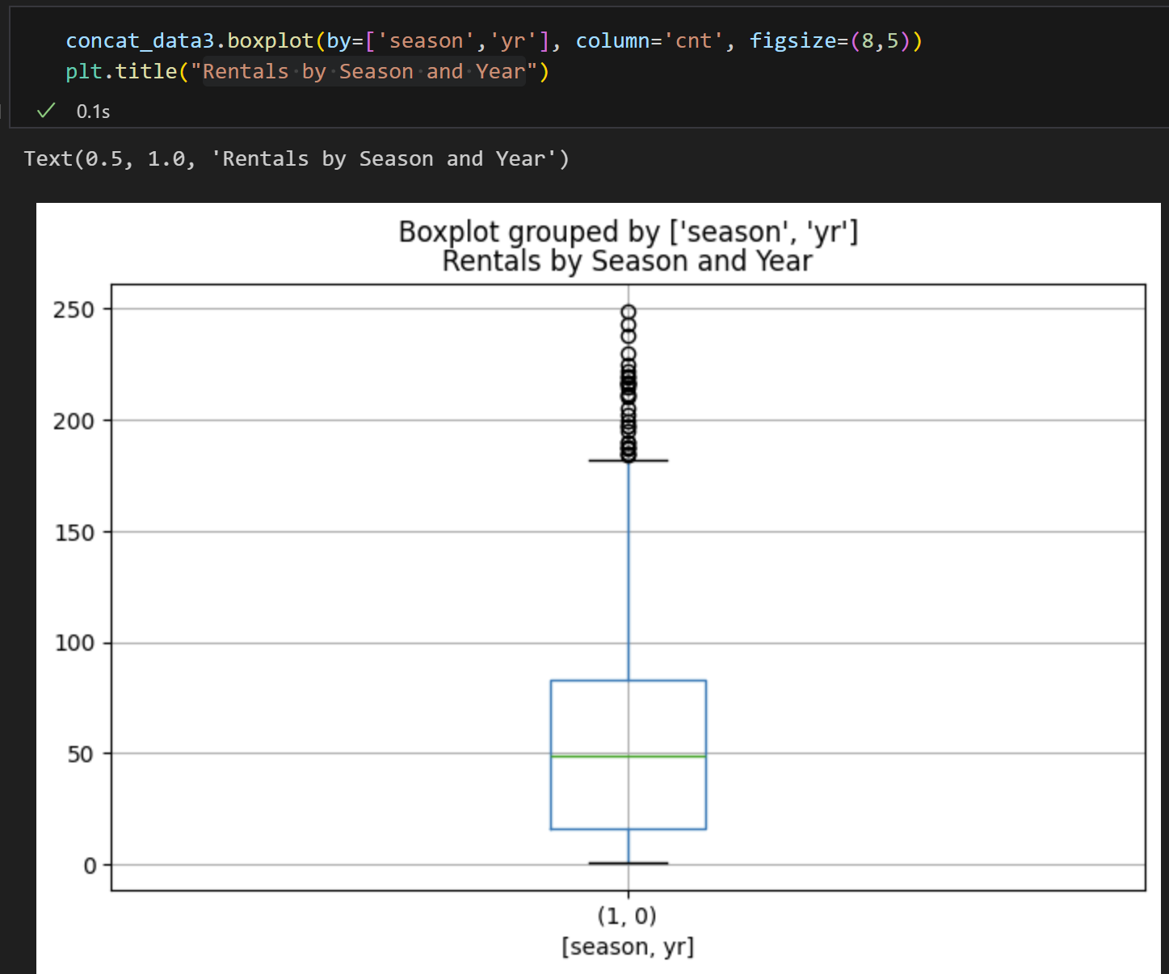
Outliers
Rentals by Season
Rentals by Season and Year

Slide 25
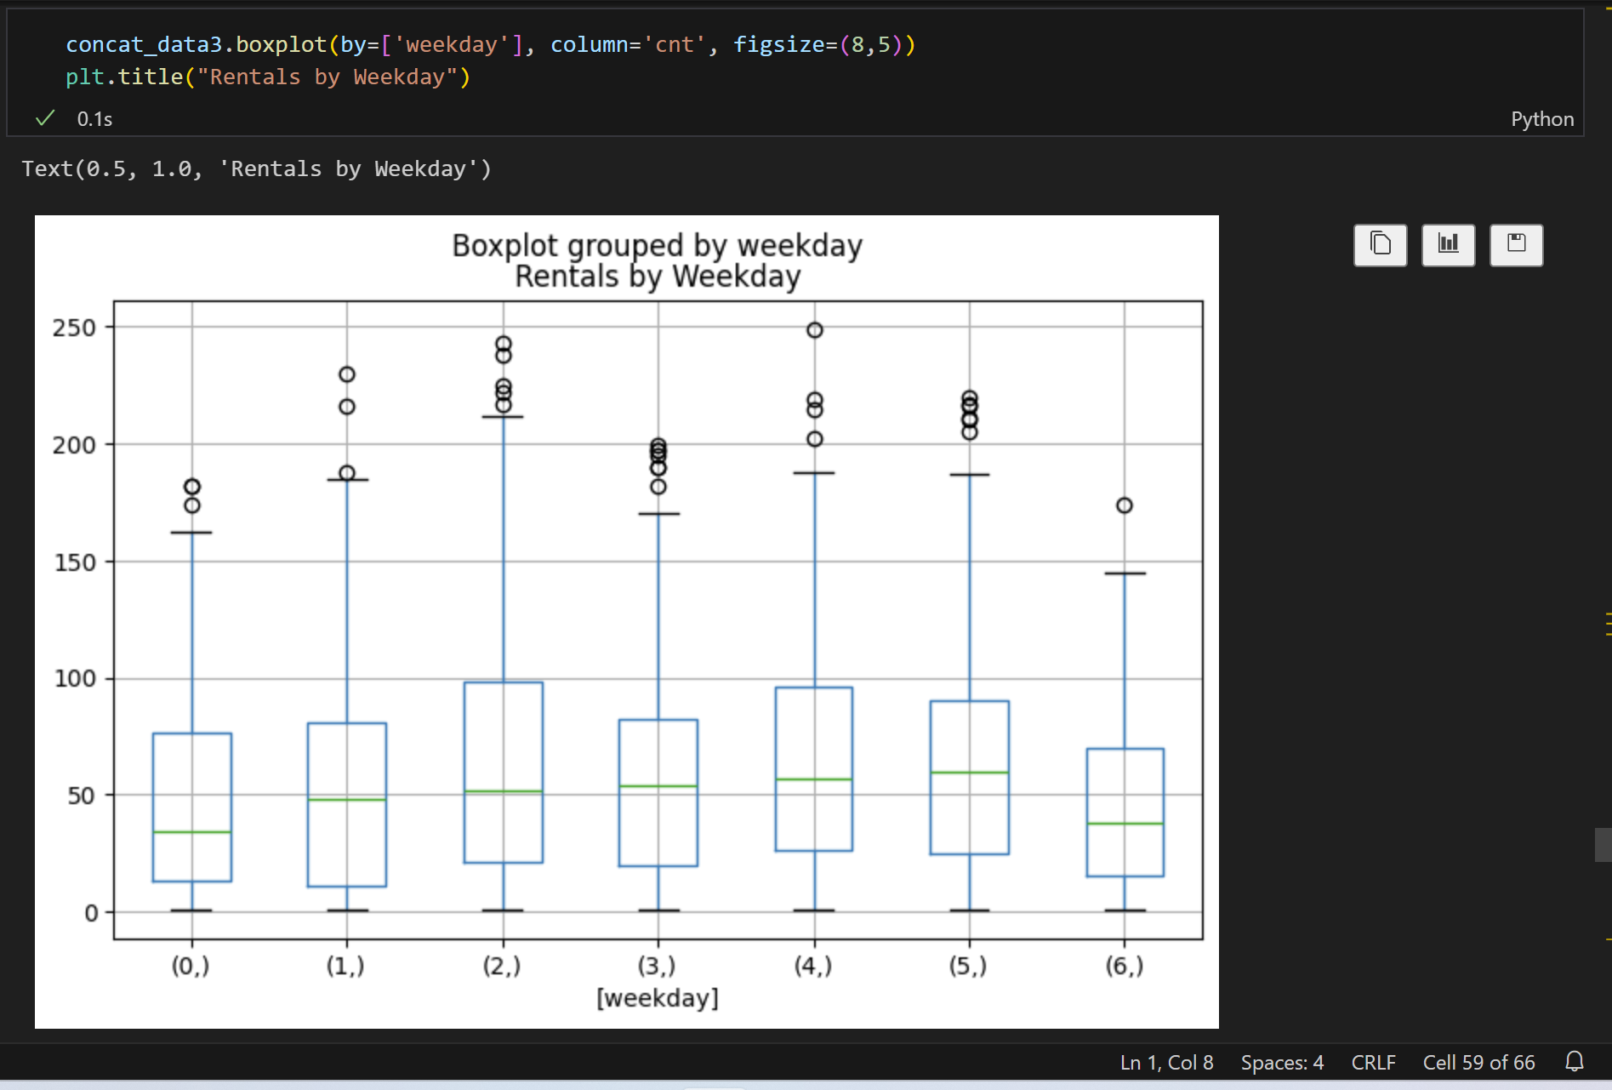
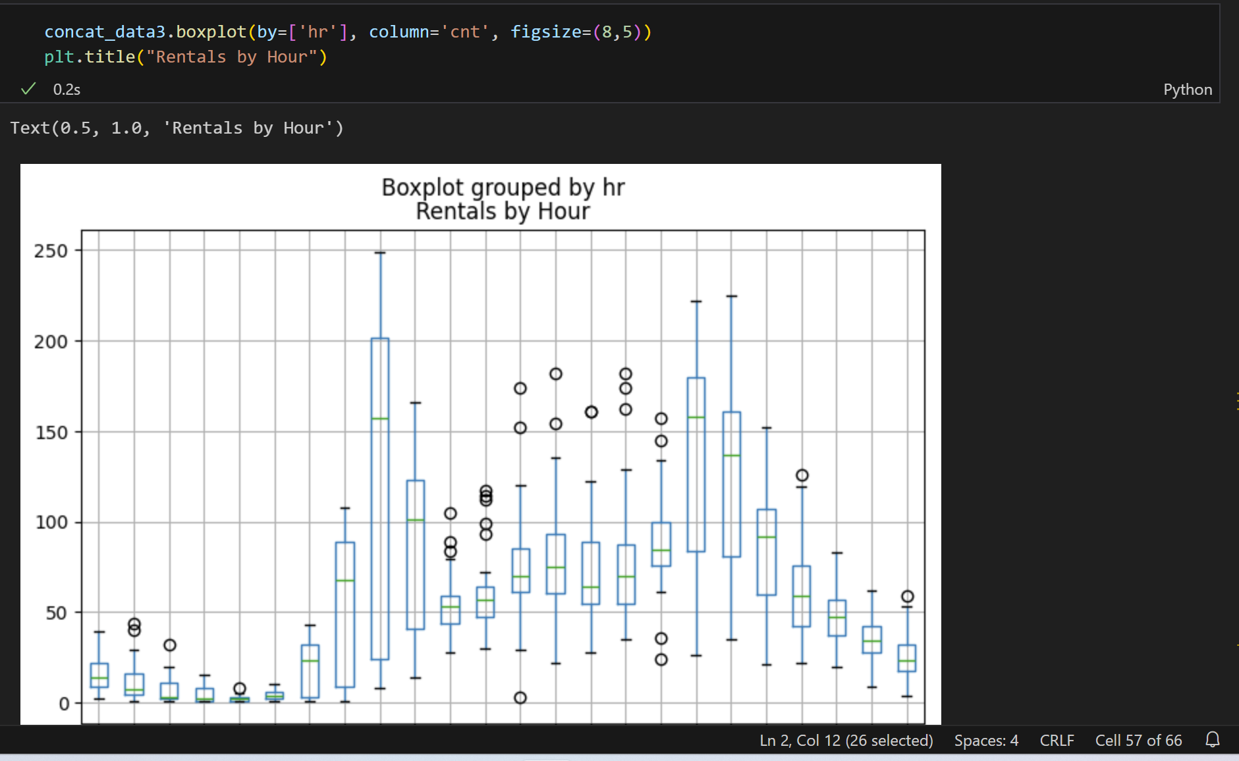
Outliers
Rentals by Hour
Rentals by Weekday

Slide 26
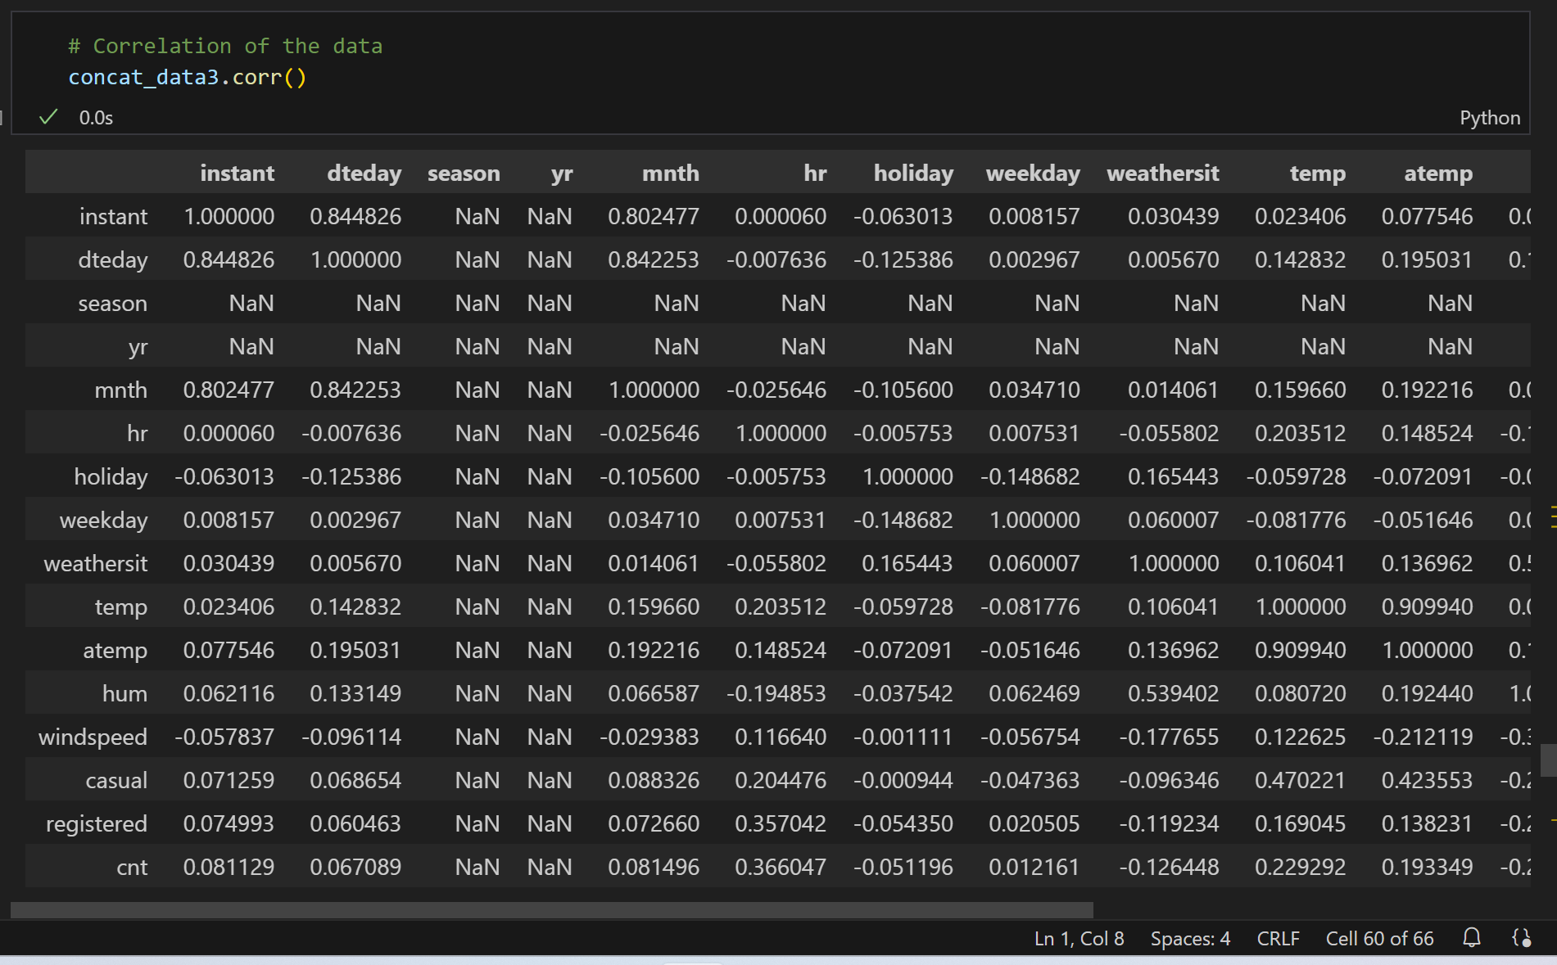
CORRELATION OF THE DATA

Slide 27
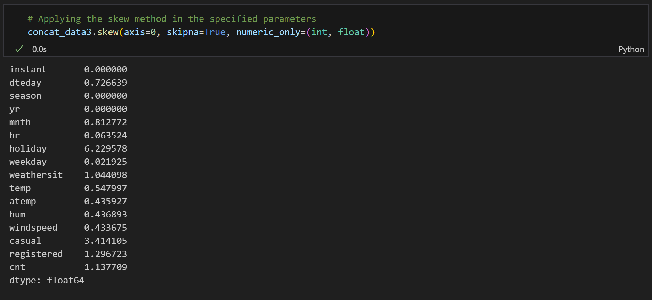
Skewness

Slide 28
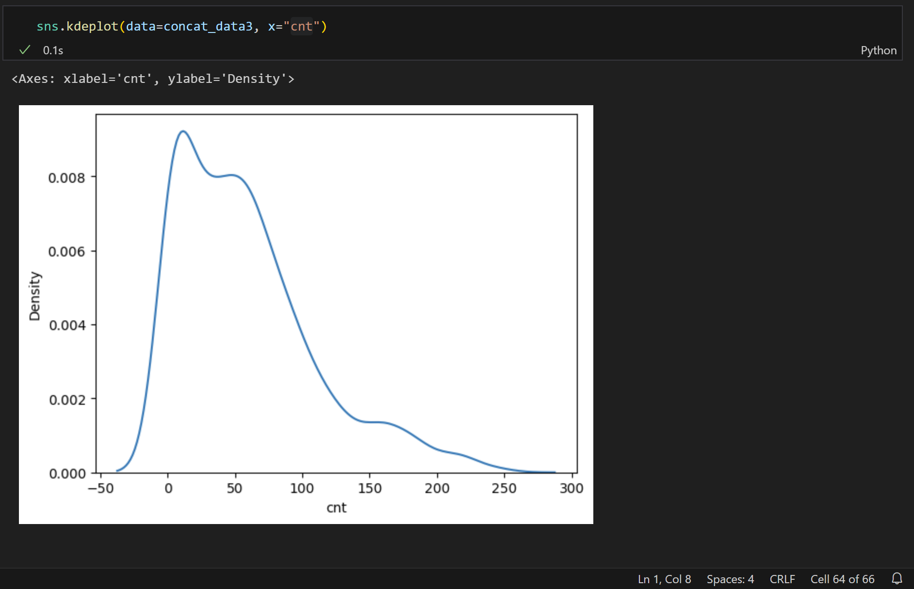
Plot univariate distribution
Cnt

Slide 29
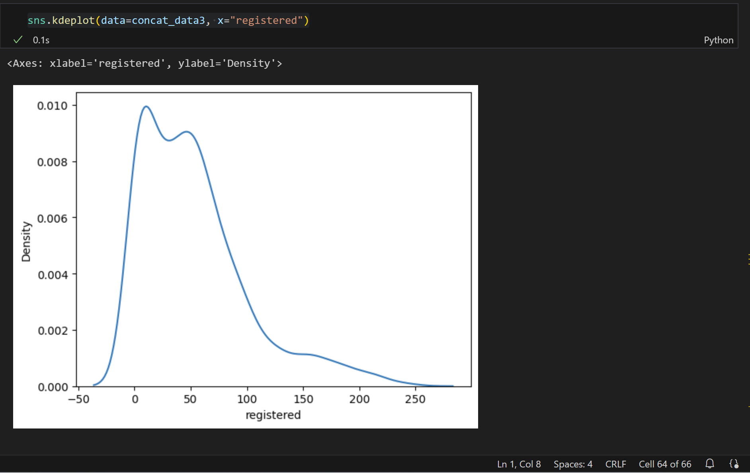
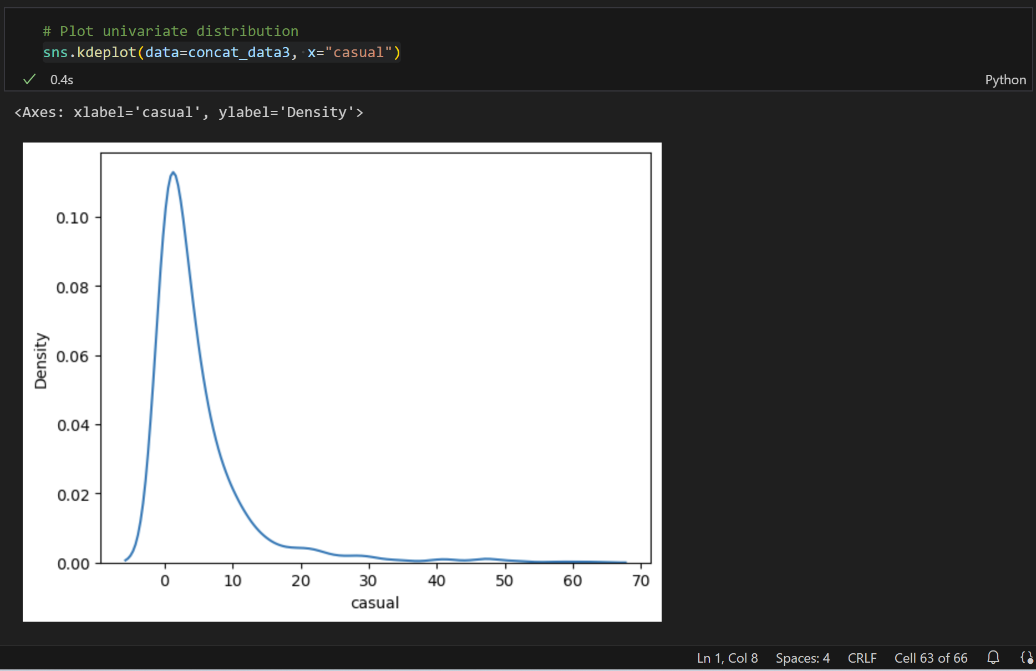
Plot univariate distribution
Registered
Casual

Slide 30
Conclusion
Type of project: Data Acquisition & Data Wrangling Dataset selection: Used the datasets provided by the Mentor. Discarded fields: Unnamed: 0 Features: ‘season’, ’ yr’, ’ mnth’, ’ hr’, ’ holiday’, ’ weekday’, ’ workingday’, ’ weathersit’, ’ temp’, ’ hum’, ’windspeed’ Label : ‘cnt’ Libraries used : Pandas, Numpy, Matplotlib, Seaborn.
. Import the data. Analyze the data. . Drop the irrelevant fields. . Understand the data. . Preprocess the data for modelling (Data Cleaning). . Work on central tendency. . Worked on missing values and outliers.
. Check the skewness and correlation of the data. . Analyze the data through visualizations using Boxplot.
The figures of rentals changes depending on the features given in the dataset.

Slide 31
THANK YOU

